Slide 1
Presentation of ANR EXAMIN
Irmela Zentner, Cécile Cornou, Florent De Martin, Pierre Gehl
Séminaire SINAPS@- ARGONET, Argostoli 25-26 sept 2018

Slide 2
EXAMIN
Project Identity
Program : Appel à projets générique 2017 - Interactions Homme-environnement
Title: EXperimental Assessment and Modelling of ground motion spatial variability for performance based seismic risk assessment of industrial plants and Infrastructures
Partners: EDF R&D, BRGM, Université Grenoble Alpes - IsTerre
Project leader : Irmela Zentner (EDF R&D)
Duration: Novembre 2017-2021 (4 years)
Budget: Total cost: 1 066 636,13 euros
Funding from ANR: 476 548,14 euros

Slide 3
EXAMIN
Objectif: Development of an integrated approach for regional risk assessment accounting for spatial variability at different scales
Work program
Developments of methods for the identification of soil variability at local scale (correlation length, variance) by ambient noise from Argostoli site
Simulations (« physics-based ») of wave propagation for the Grenoble basin, modelling of spatial variability at local (random fields) and regional scale, uncertainty propagation, construction of metamodels for regional risk analyses
Analyses of impact of spatial variability on structural response and vulnerability (evaluation of fragility curves)
Integration into a Bayesian network for risk and loss assessment at regional scale

Slide 4
EXAMIN
Scheme of the integrated approach implemented in the framework of the project
Hazard
Experimental characterization
Spatial soil variability
3D variable medium
Wave propagation simulation
Waveform database
Meta-model
Exposure / Vulnerability
SSI Multi-support load
Fragility curves
Probabilistic scenarios
Monte-Carlo simulations
Local
Regional
Structure
Facility
Infrastructure
Risk
Bayesian Networks
Decision-making support

Slide 5
EXAMIN
Workpackages & leaders
WP 1 : Physical experimental characterization of spatial soil variability (IsTerre, C. Cornou)
Caractériser la variabilité spatiale des propriétés du sol expérimentalement par bruit ambiant
WP 2 : Numerical modelling of wave propagation at local and regional scale (BRGM, F. De Martin)
Modélisation numériques de la propagation des ondes de la source au site tenant compte de la variabilité à différentes échelles
WP 3 : Impact of spatial variability on structural response and vulnerability (EDF, I. Zentner)
Evaluation de l’impact de la variabilité sur les structures, calcul de courbes de fragilité
WP 4 : Integration for risk assessment (BRGM, P. Gehl)
Les information sont intégrées dans la chaine d’analyse de risque (réseaux Bayésiens).

Slide 6
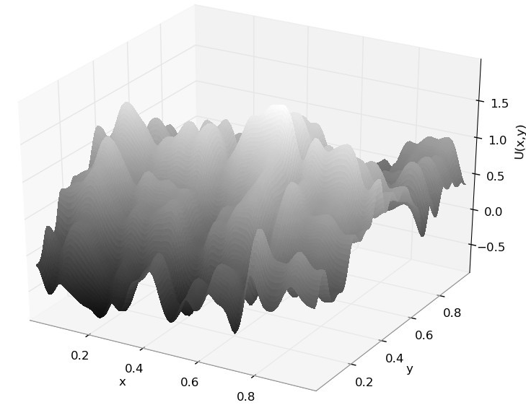
EXAMIN
Numerical modelling
Horizontal and vertical variability of soil properties
- 3D models
Material properties take positive values
Lognormal distribution
Data needed to construct the random fields
- Mean m_{G} + std σ (ou COV) + 3 correlation lengths (x,y,z)
Gaussian random field
Analytical expressions for 3D random fields by the Karhunen-Loève expansion – implementation in Code_Aster (and EFISPEC)

Slide 7
EXAMIN
Identification of spatial variability of soil at local scale by ambiant noise
→ Determine correlation length and coefficient of variation of S-wave underground properties for the random fields
Investigation of noise interferometry in terms of amplitude variation (link with heretoregenity characteristics)
Investigation of coherence on active and passive seismics for estimating spatial variation properties
Argostoli test site
→ Experimental campaign June 30th – July 11th
Participants
ISTerre: C. Cornou, B. Guillier, P. Ballaz, L. Gisselbrecht
ITSAK: N. Theodulidis, Ioannis
Kyoto univ. : H. Kawase
Equipment: 65 wireless geophones (3 components) + seismic equipment
Location: ArrayA_NERA + Rock_SINAPS@

Slide 8
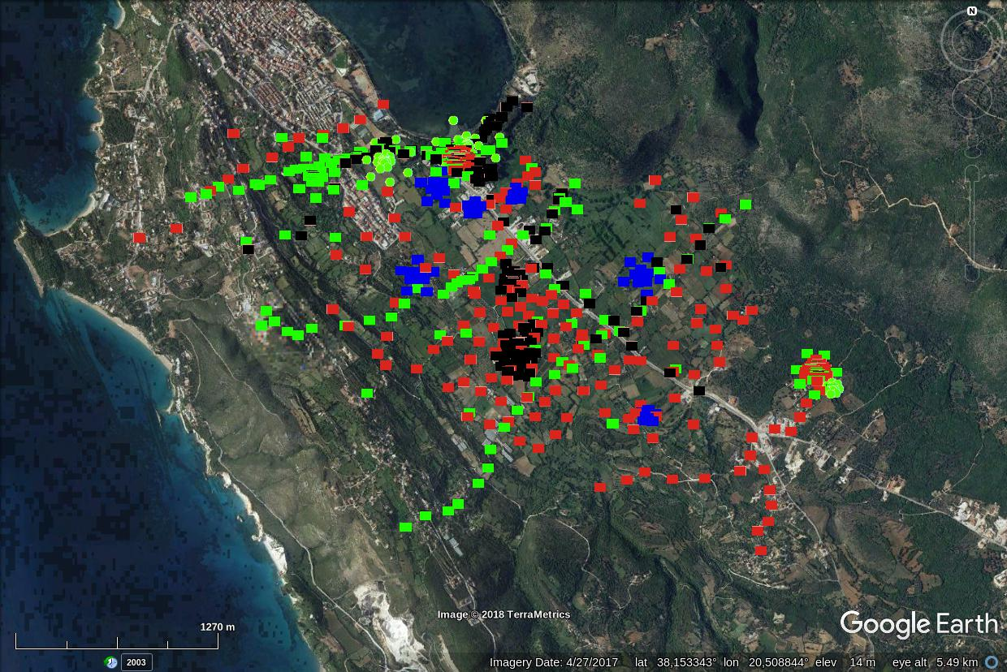
EXAMIN
Experimental assessment at Argostoli july 2018 , ISTerre (Cécile Cornou)
NERA 2011-2012 : seismological network + ambient noise measurements (H/V and array)
SINAPS 2013-2014: seismological network + ambient noise measurements (H/V and array)
EXAMIN 2018: array noise measurements
EXAMIN 2018 : H/V + noise interferometry

Slide 9
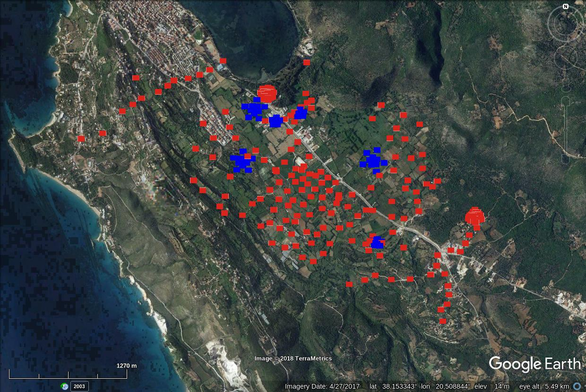
EXAMIN
Measurements type:
Seismic profiles (S-waves seismic tomography)
Noise measurements (4 days / site)
+ H/V measurements in the valley (2 days measurements) for contributing to
3D basin model building
EXAMIN 2018: array noise measurements
EXAMIN 2018 : H/V + noise interferometry

Slide 10
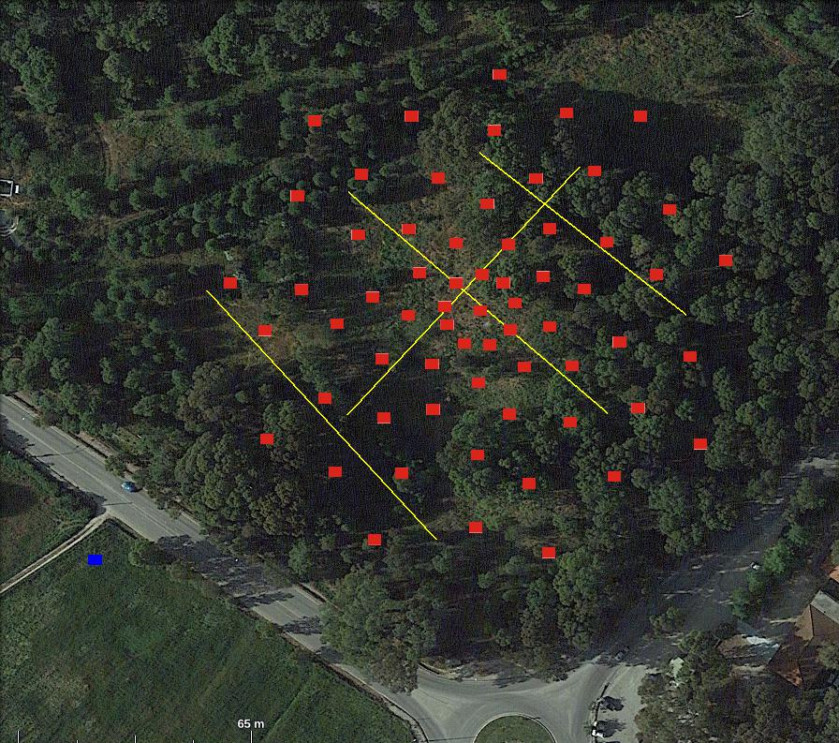
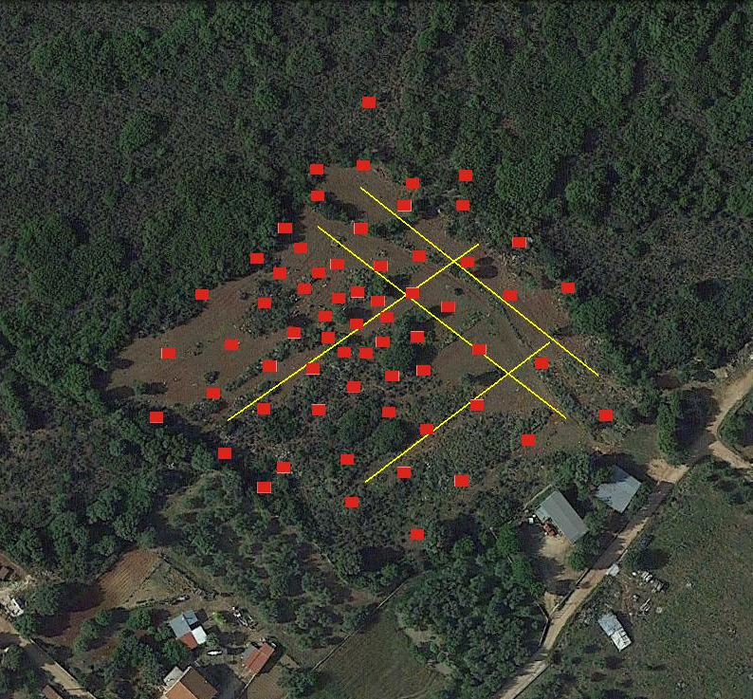
EXAMIN
48 h of measurements
ROCK SITE
48 h of measurements
SEDIMENT SITE
P- and S- wave tomography
P- and S- wave tomography

Slide 11
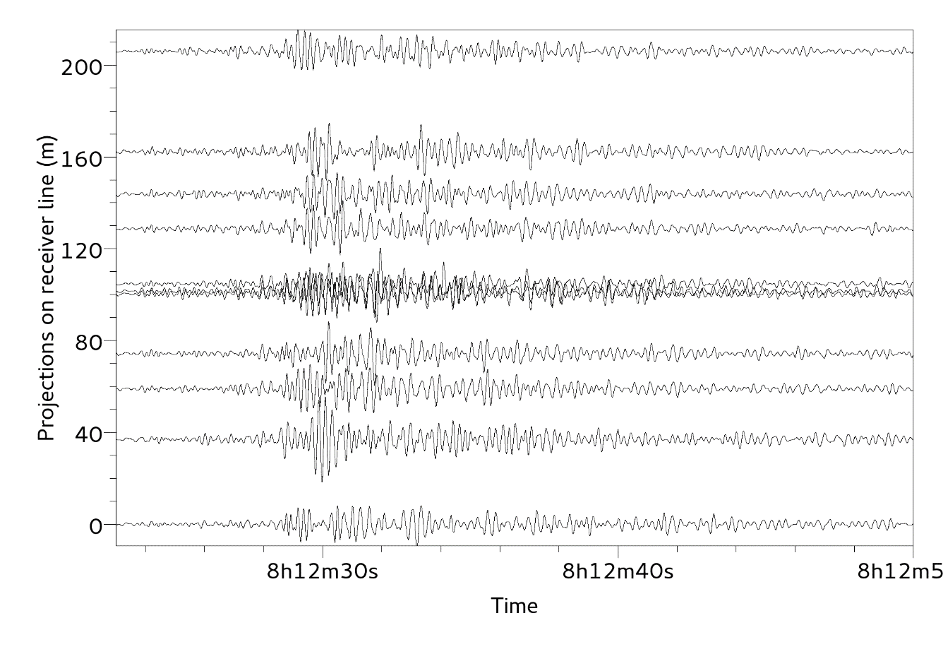
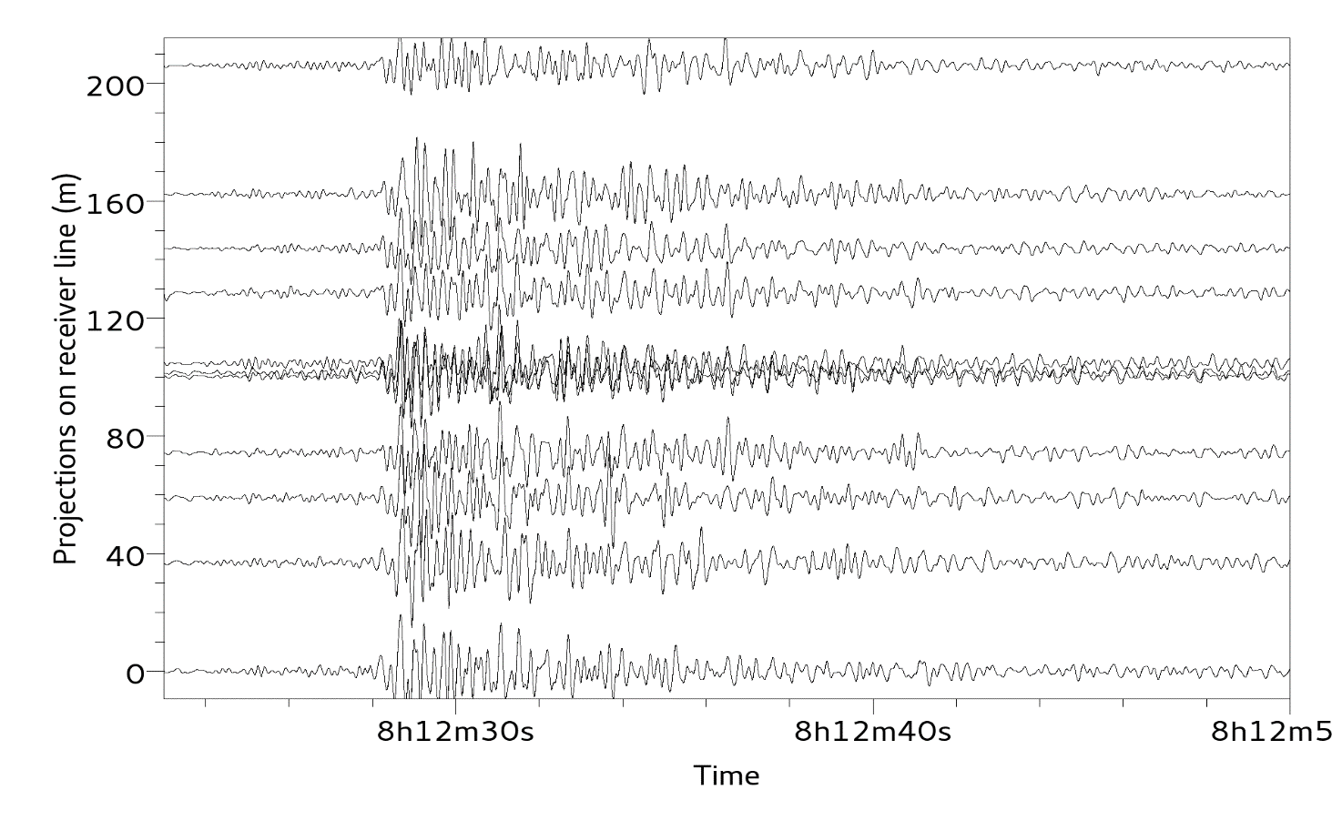
EXAMIN
Velocities recorded during a local earthquake
[not found in the NOA catalog so far]
Vertical comp., [1 8] Hz band-pass filtered
North comp., [1 8] Hz band-pass filtered

Slide 12
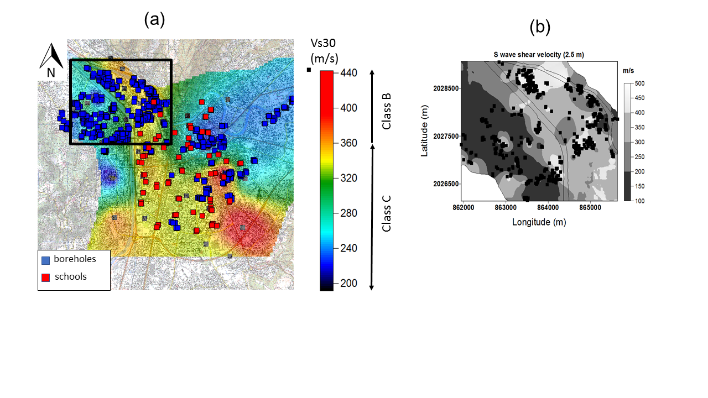
EXAMIN
Modeling of local and regional variability for loss assessment
→ Numerical simulation of wave propagation to define spatial distribution of ground motion
Application to the Grenoble basin

Slide 13
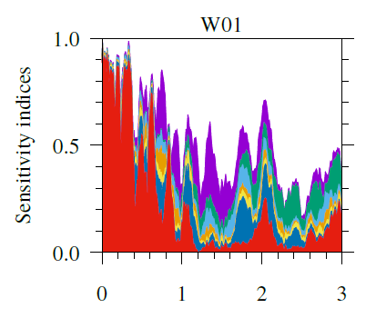
EXAMIN
Numerical simulation
« Physics-based » simulation of wave propagation from source to site by spectral element method (EFISPEC3D)
Local variability by random fields + regional variability,
Uncertainty propagation, Sensitivity analyses to detect important variables and features
Construction of métamodels for a couple of seismic scenarios (Mw=4,5,6) to be used for regional risk analyses,
Determine spatial correlation models and compare to classical models of literature (correlation and coherency)

Slide 14
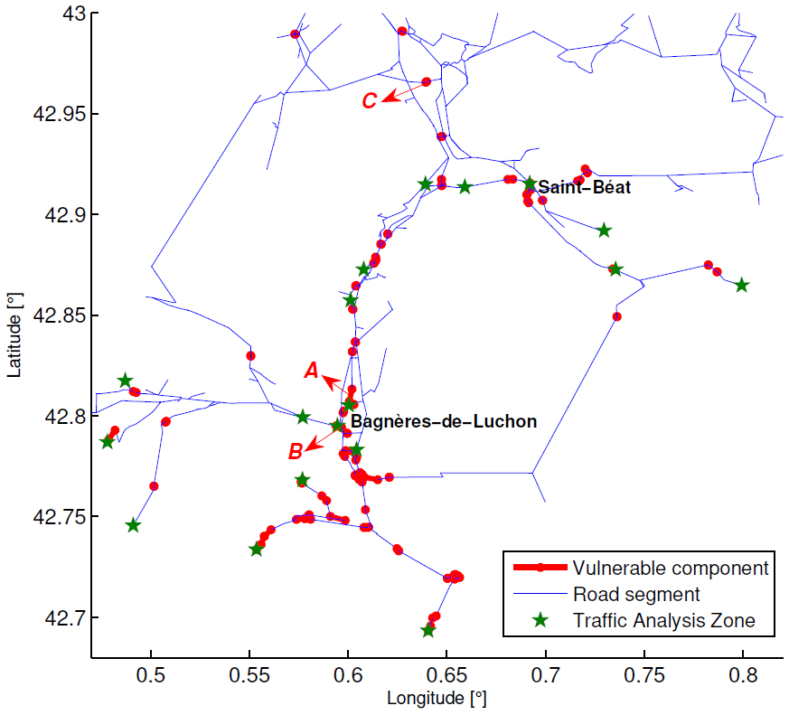
EXAMIN
Fragility and Regional risk analyses
Development of broad band motion for SSI studies and fragility analyses
Simulation of damage states (bridges, road, power network) by probabilistic model for selected scenarios
→ Replace the GMPE and isotropic spatial correlation by the metamodel obtained by numerical simulation + uncertainty propagation featuring spatial correlation specific to the studied zone
Bayesian network

Slide 15
EXAMIN
Conclusion
Développement d’une approche intégrée pour l’analyse de risque régionale tenant compte de la variabilité du mouvement à différentes échelles, en s’appuyant sur une approche réseaux Bayésiens pour l’analyse de risque
Identification de la variabilité du sol à l’échelle locale (longueur de corrélation, variance) par bruit ambiant
Simulation « physics-based » de la propagation des ondes pour le bassin de Grenoble, modélisation de la variabilité par champ aléatoires, propagation des incertitudes, comparaison aux mesures et construction de métamodèles pour les analyses de risque régionales
Développement de mouvements large bande pour études d’ISS et calcul de courbes de fragilité

Slide 16
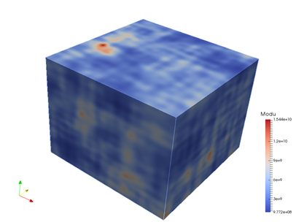
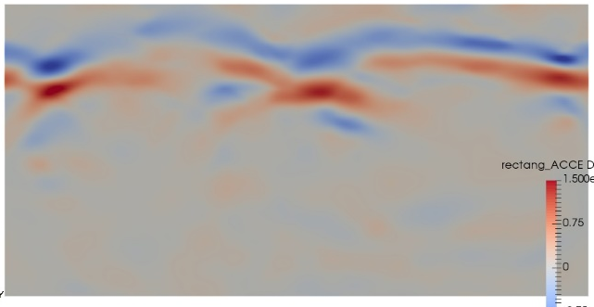
EXAMIN
For more information: http://anr-examin.brgm.fr/
Thank you
Contact: Irmela.zentner@edf.fr

